Slide 1

TASK #1
PHISHING AWARENESS TRAINING
Made By:
Kanwar Azlan
Cybersecurity Internee

Slide 2
WHAT IS PHISHING
Phishing is a type of computer attack in which an attacker poses as a legitimate organization to trick individuals into sharing sensitive information such as:
Passwords
Credit card numbers
Personally identifiable data
Examples of phishing
Fake emails pretending to be from a bank
Fake websites impersonating popular services
SMS requesting login credentials

Slide 3
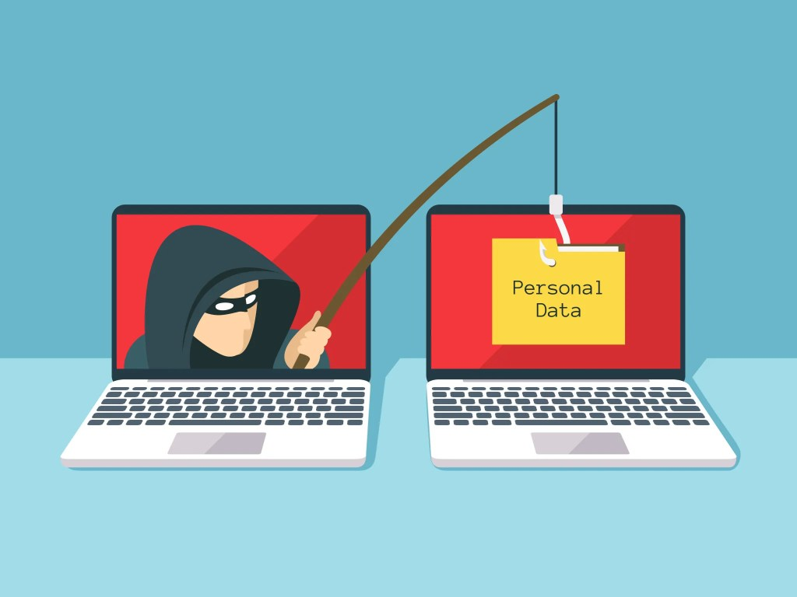
WHY DO PHISHING ATTACK WORKS
Psychological Tactics
Urgency:
"Your account will be suspended in 24 hours!"
Trust:
Using trusted logos and sender names (e.g., your bank or employer)
Fear:
Threat of financial loss or security compromise
Greed:
Promises of rewards or refunds

Slide 4

TYPES OF PHISHING ATTACK (1)
EMAIL PHISHING
In a phishing email scam, the attacker sends an email that appears authentic and is designed to trick the recipient into entering information in a reply or on a site that the hacker can use to steal or sell their data.

Slide 5

TYPES OF PHISHING ATTACK (2)
SPEAR PHISHING
Spear phishing involves targeting specific individuals within an organization in an attempt to steal their login credentials. Attackers will often first gather information about that individual, such as their name, job title, and contact details, before launching an attack.

Slide 6
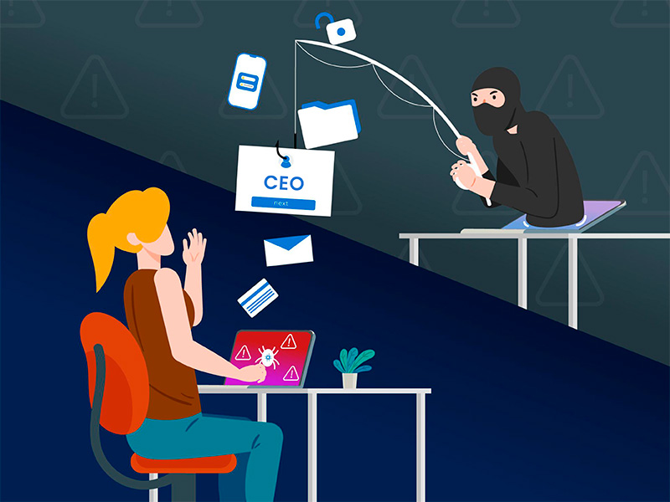
TYPES OF PHISHING ATTACK (3)
WHALING
Whaling attacks are phishing attacks that target senior executives, who often have deep access to sensitive areas of a network, allowing a successful attacker to gain access to valuable information.

Slide 7
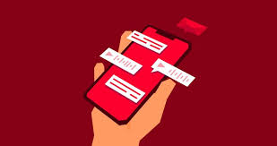
TYPES OF PHISHING ATTACK (4)
SIMISHING
Smishing is a type of phishing scam that involves text messages, or SMS. Hackers posed as American Express employees and sent text messages to victims telling them they needed to take control of their accounts. The message states that it is urgent, and when the victim clicks on it, they are directed to a fake site where they are forced to enter their personal information.

Slide 8

TYPES OF PHISHING ATTACK (5)
VISHING
It's easy for someone to use a phone to steal information for "Phishing Voice". Attackers can claim that he is a trusted friend or parent, or represent them.

Slide 9

TYPES OF PHISHING ATTACK (6)
PHARMING
In pharmaceutical attacks, victims receive malicious code on their computer. Next, this code sends the victim to a false website designed to collect accounting data for entry.

Slide 10
HOW TO IDENTIFY PHISHING EMAILS
Suspicious Sender
{- Looks on Sender’s email address only -}
Generic greetings
{- It says “Dear Customer” instead of your name -}
Threatening language
{- “Urgently Subscribe Now” or you will lose -}
{- Poorly written Or grammar mistakes -}
Misspelling Errors
{- Before clicking, just hover at the link -}
Suspicious Links
{- Never open Unexpected attachments -}
Unsolicited Docs

Slide 11
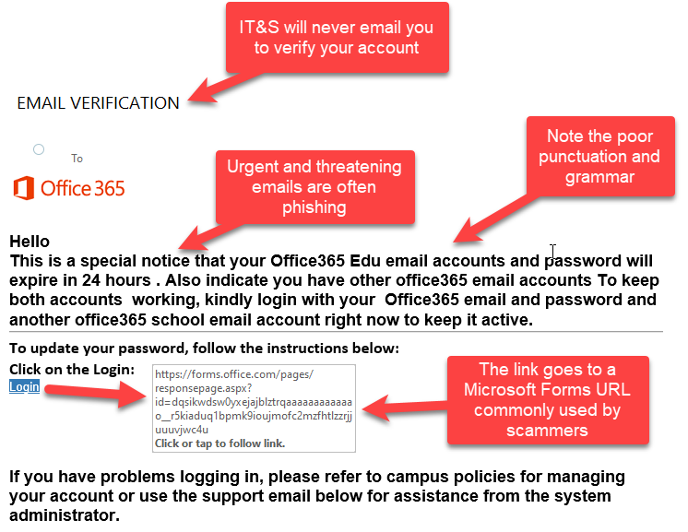
EXAMPLE OF A PHISHING EMAIL (1)

Slide 12
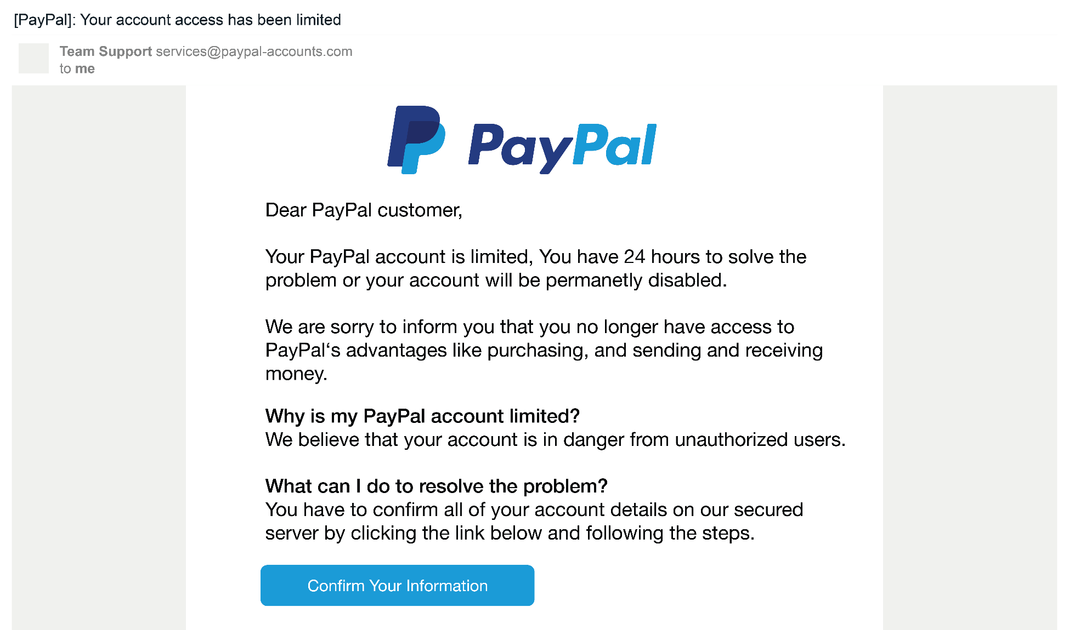
EXAMPLE OF A PHISHING EMAIL (2)

Slide 13
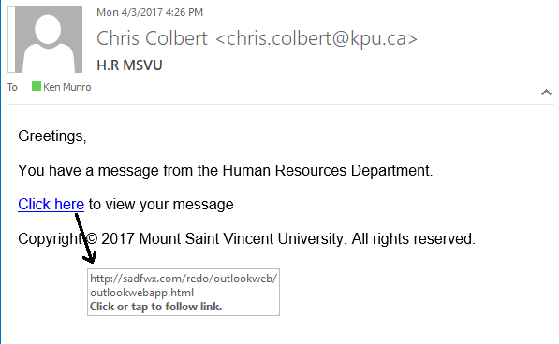
EXAMPLE OF A PHISHING EMAIL (3)

Slide 14

SOCIAL ENGINEERING TACTICS
Manipulating individuals to gain confidential information
Common Techniques:
Pretext
Create a fabricated story to gain trust.
Bait
Offer free downloads (e.g., files infected with malware). Give them something in return
Quid Pro Quo
Offer them a service or perk in exchange for their data.
Impersonation
Pretend to know them (your boss, IT support)

Slide 15
HOW TO AVOID PHISHING ATTACKS
Verify Sender
Contact the Sender Directly
Think before Click
Hover on the link to check the destination
Enabling MFA
Add the extra layer of security
Anti-phishing Tools
Filter the emails and extensions
Stay Updated
Keep your software's updated

Slide 16

INTERACTIVE QUIZ
Q = What are the key signs of a phishing email?
Q = What should you do if you receive a phishing email?

Slide 17



THANK YOU
Stay Alert, Stay Safe
services.codealpha@gmail.com
www.codealpha.tech
CodeAlpha

